Slide 1
Moving to New York City
IBM Applied Data Science – capstone project
M.Sc. Jacobo Perez

Slide 2
Introduction (1/3)
Moving into a new city, or even changing neighborhoods is challenging. Suppose a client wants to live nearby a subway station for easy commuting, what are the best alternatives?

Slide 3
Introduction (2/3)
Machine Learning techniques may be the answer, by clustering neighborhoods and finding relationships inside data.

Slide 4
Introduction (3/3)
Each client is different, so it can specify must-have venues close to home, and others relevant that would like to have. The must-have’s are used as filters, the other’s for clustering. Price is always an important factor, we may cluster neighborhoods by cost.

Slide 5
data
Foursquare is a webpage containing lots of data of venues. It has an API which allows developers to obtain its information regardless of the webpage format.
Subway stations and their coordinates are obtained from MTA website in a csv file.
http://web.mta.info/developers/data/nyct/subway/Stations.csv

Slide 6
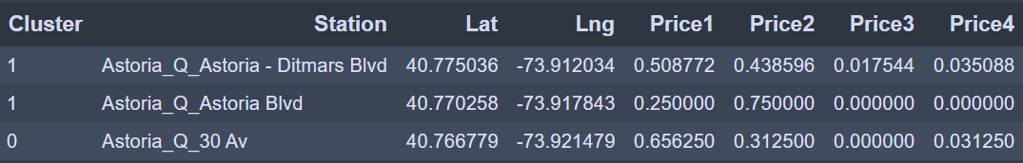
METHodology
Obtain subway stations from MTA.
Obtain restaurants in price range 1-4 in surroundings as cost proxy.
Perform K-means clustering on those prices.

Slide 7
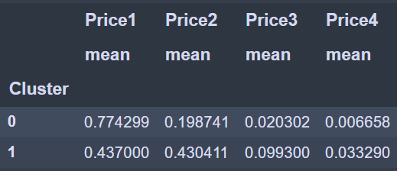
METHodology
Obtain subway stations from MTA.
Obtain restaurants in price range 1-4 in surroundings as cost proxy.
Perform K-means clustering on those prices.

Slide 8
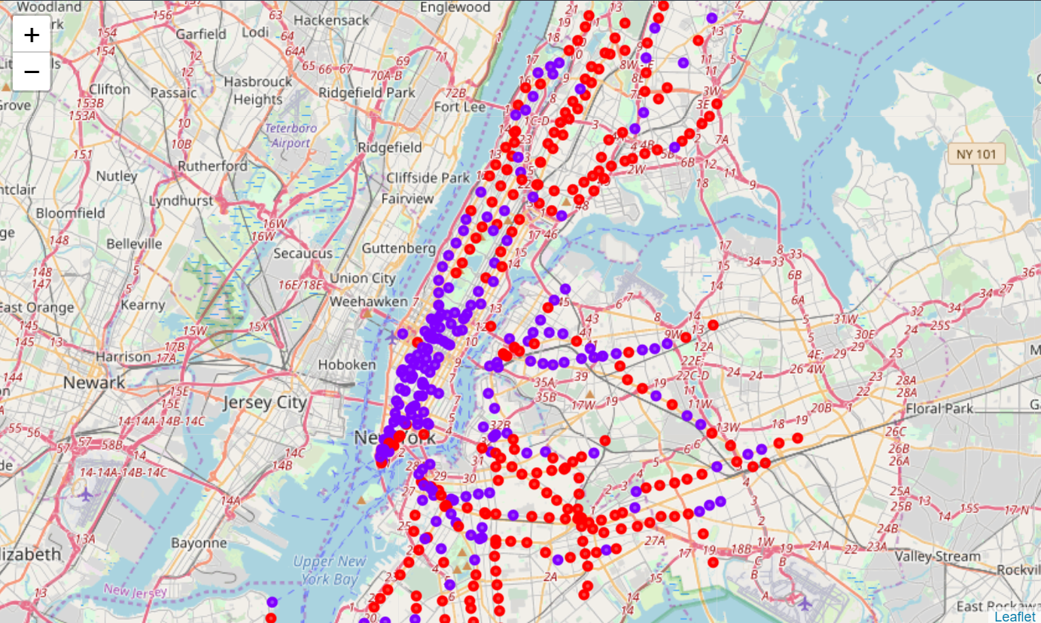
METHodology
NYC clustered by price estimate.

Slide 9
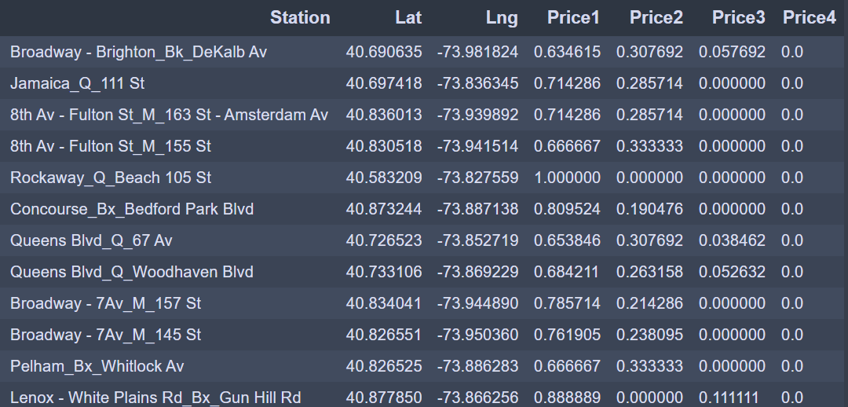
METHodology
Client selects desired price level.
All venues are obtained nearby remaining stations.
Drop stations without must-have venues, below are the finalists.

Slide 10
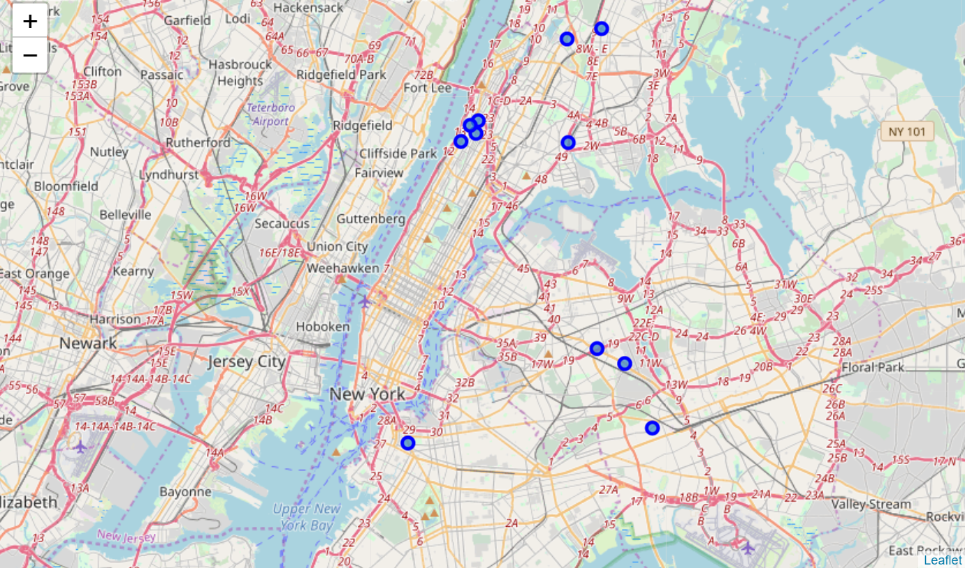
METHodology

Slide 11
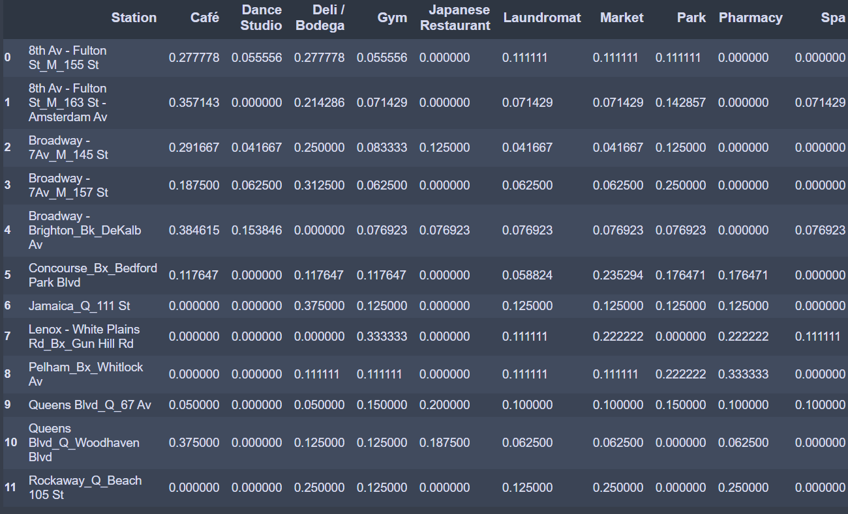
METHodology
Client also specified relevant venues, we obtain their frequencies.

Slide 12
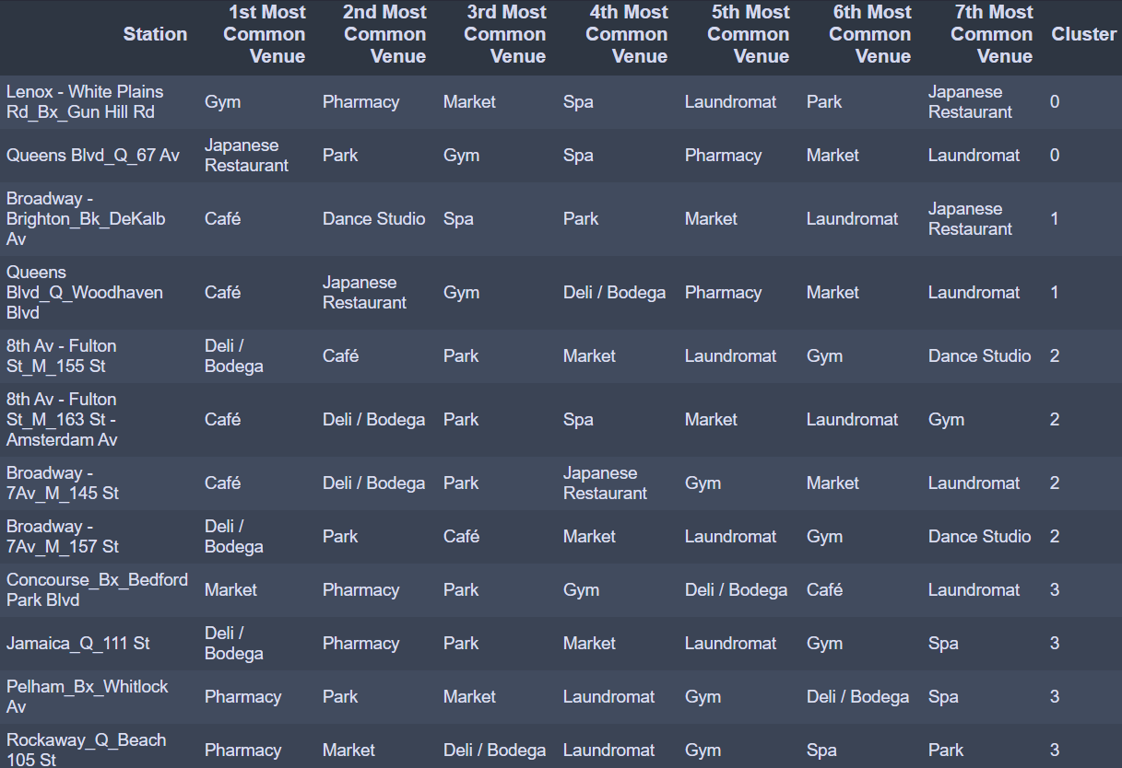
METHodology
Most common venues per station, performing K-means clustering:

Slide 13
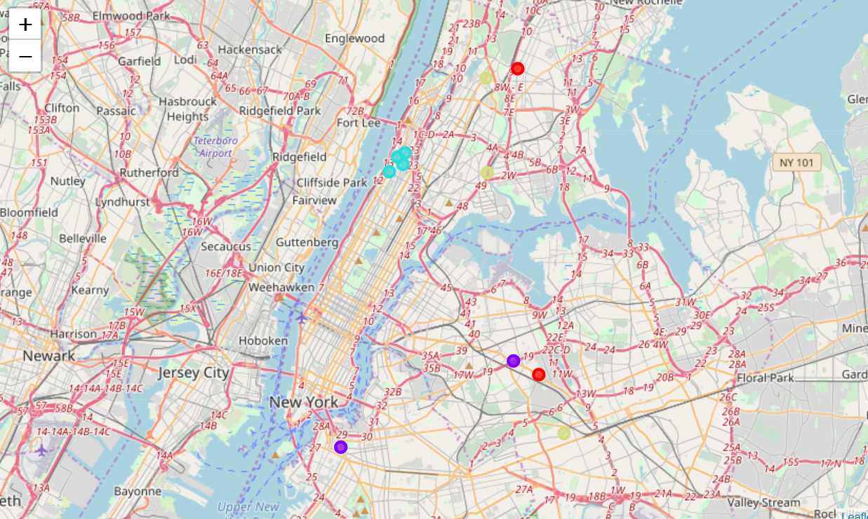
METHodology

Slide 14
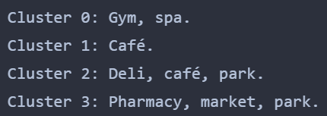
results
Expensive neighborhoods are located in Manhattan, as expected.
Cluster analysis was helpful for identifying areas with similar venues:

Slide 15
further developments
We identified the following opportunity areas:
Obtain available housing prices for sale and rental.
Obtain criminality statistics per neighborhood.
Obtain commuting estimates from each subway station to work at rush hours by different transportation means.

Slide 16
conclusion
Machine learning techniques, in this case cluster analysis, is helpful for identifying data trends.
Traditional programming would involve setting custom business rules, which may miss relevant data relationships.
Developing models in Python is very productive, as the code is readable and powerful, as there are plenty of functions and libraries in place for the programmer to use, so we can focus in the functionality.
Foursquare API is fast and very useful, although our license was very limited.
Pandas dataframes are very powerful, fulfilling all data functionalities we can think of, even obtaining tables from the internet.
Obtaining data and its preparation is hard, as information sometimes is not available or requires pre-processing.

